Slide 1
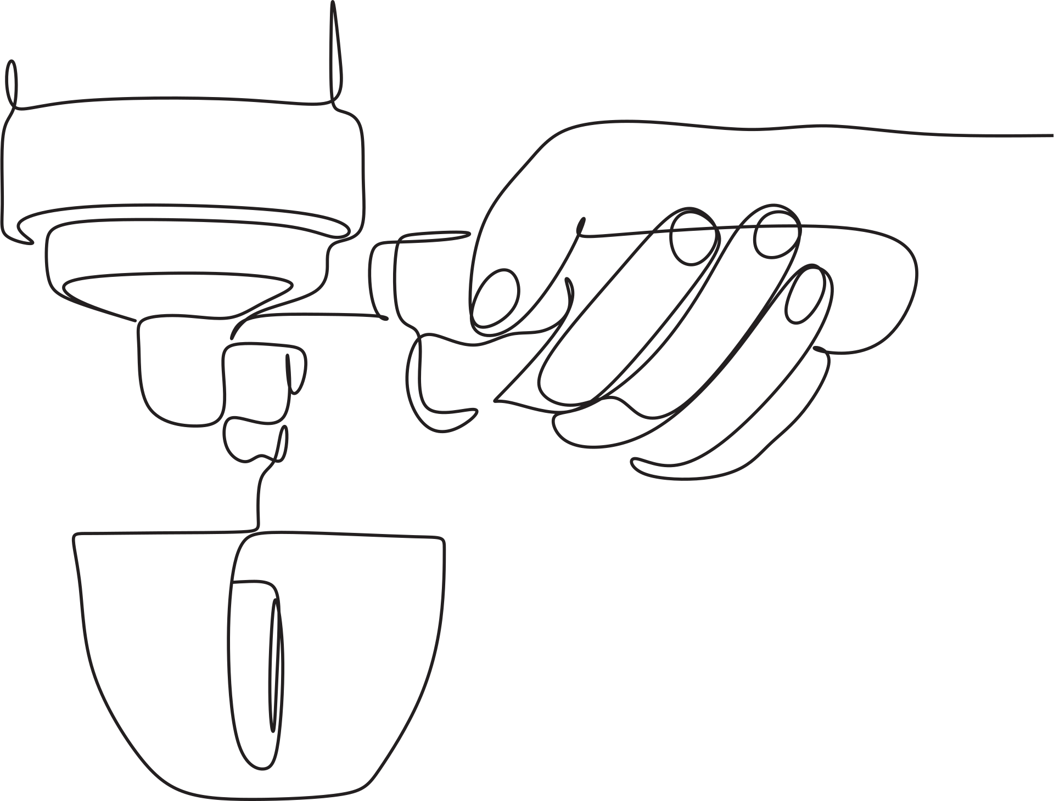
Make better coffee
TEAM 4

Slide 2

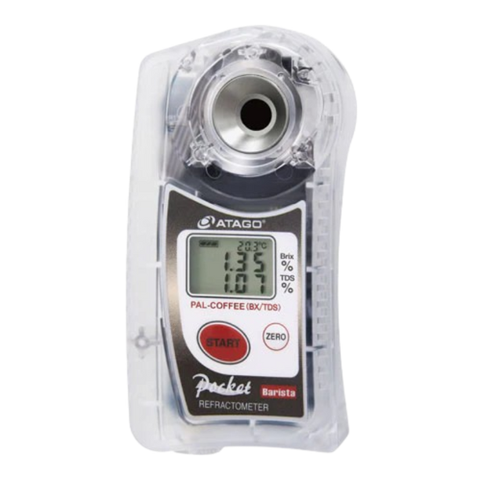




Problem Definition
coffee beans
Water
brewing
refractometer

Slide 3
Demo

Slide 4
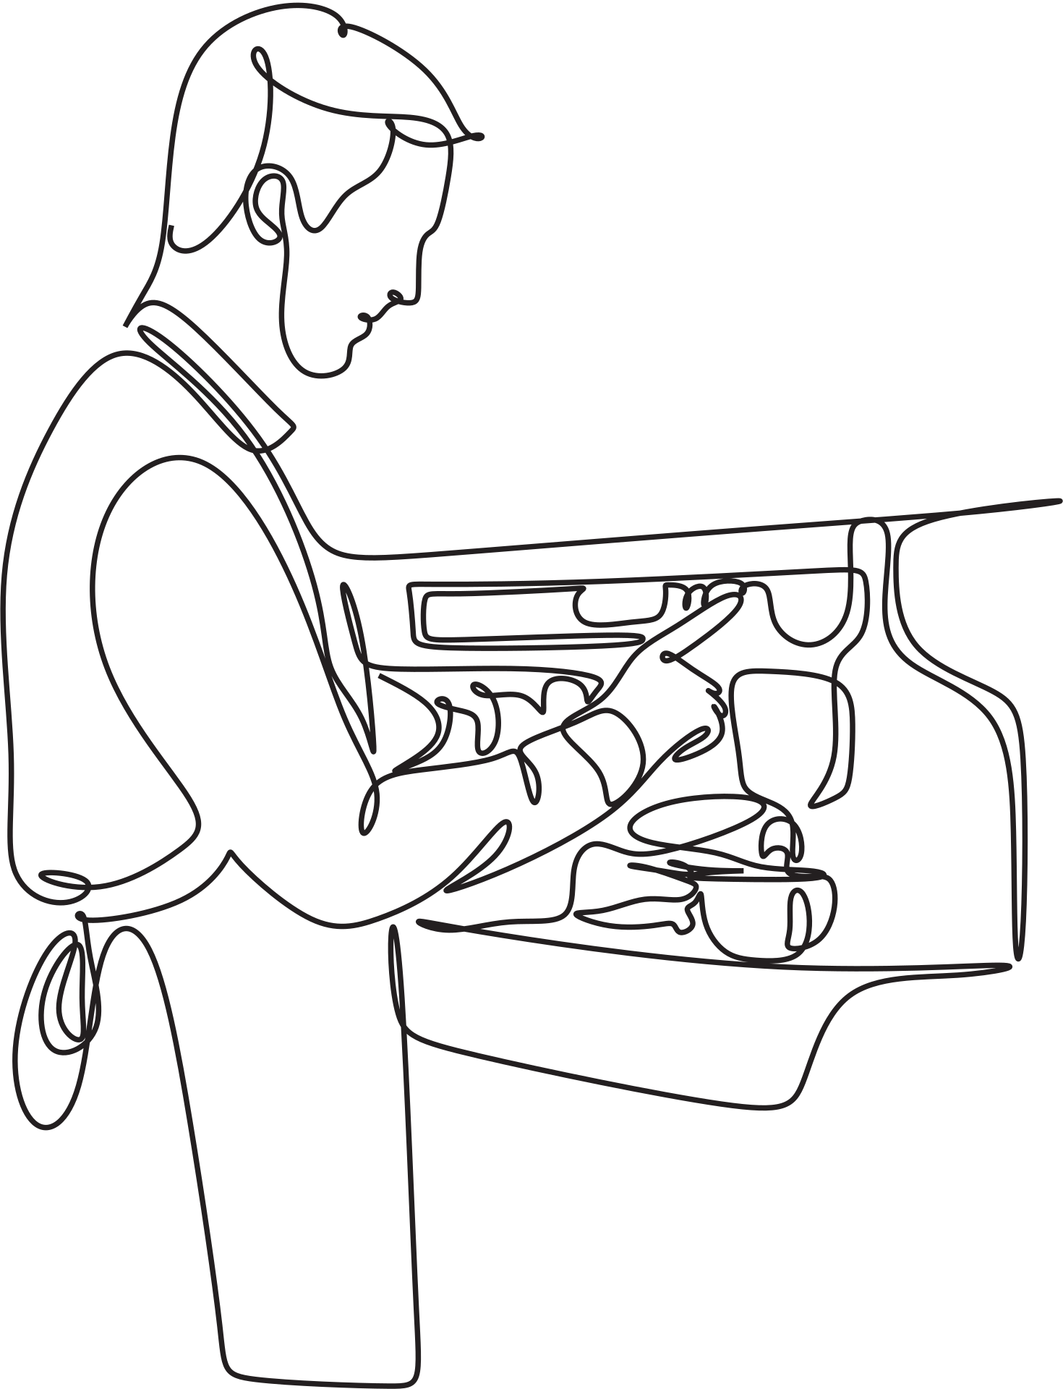
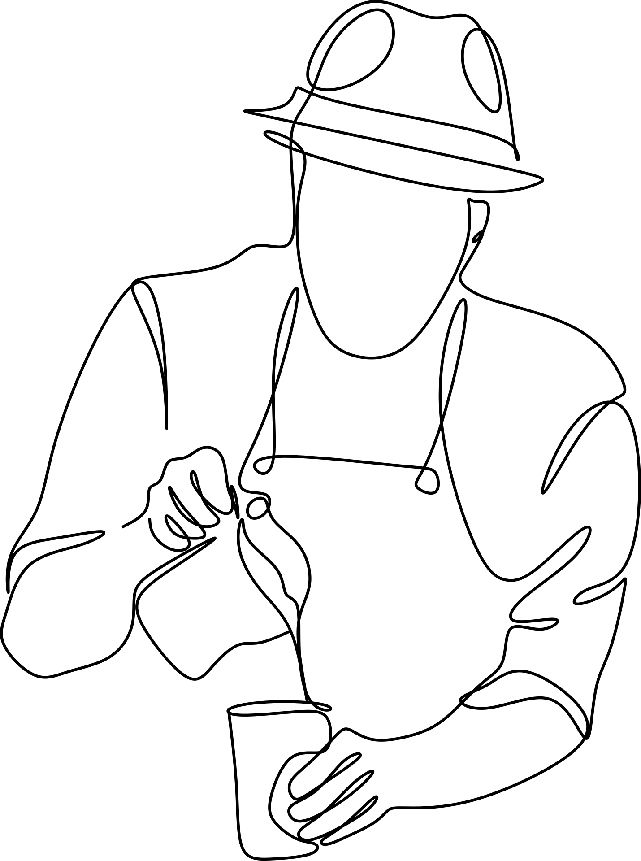
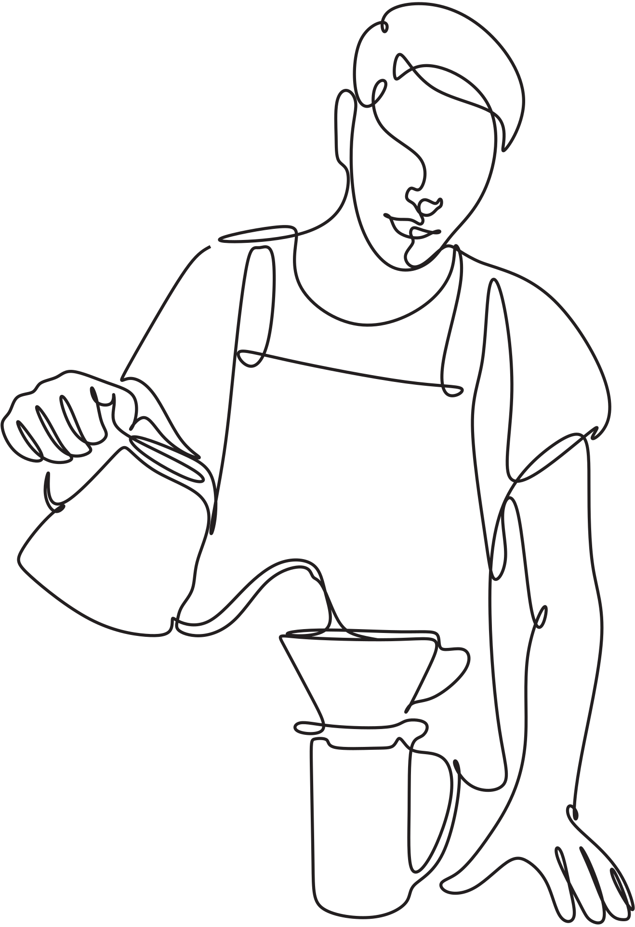
Work Flow

Slide 5

Thanks
Salwa Alshamrani Hadeel Almaylam Mohammad Alkhatim Tariq Alshammari

